Slide 1
System calls
Prepared by the student: Amal Kateb Al-Anzi
Dr.Salem Belhaj

Slide 2
System calls
a system call is a programmatic way in which a computer program requests a service from the kernel of the operating system it is executed on. A system call is a way for programs to interact with the operating system. A computer program makes a system call when it makes a request to the operating system’s kernel. System call provides the services of the operating system to the user programs via Application Program Interface(API). It provides an interface between a process and an operating system to allow user-level processes to request services of the operating system. System calls are the only entry points into the kernel system. All programs needing resources must use system calls.

Slide 3
A user program can interact with the operating system using a system call.
A number of services are requested by the program, and the OS responds by launching a number of systems calls to fulfill the request.
A system call can be written in high-level languages like C or Pascal or in assembly language.
If a high-level language is used, the operating system may directly invoke system calls, which are predefined functions.

Slide 4
Services Provided by System Calls
Process creation and managementMain memory managementFile Access, Directory, and File system managementDevice handling(I/O)ProtectionNetworking, etc.Process control: end, abort, create, terminate, allocate, and free memory.File management: create, open, close, delete, read files,s, etc.Device managementInformation maintenanceCommunication

Slide 5
Features of System Calls
Interface: System calls provide a well-defined interface between user programs and the operating system. Programs make requests by calling specific functions, and the operating system responds by executing the requested service and returning a result.Protection: System calls are used to access privileged operations that are not available to normal user programs. The operating system uses this privilege to protect the system from malicious or unauthorized access.Kernel Mode: When a system call is made, the program is temporarily switched from user mode to kernel mode. In kernel mode, the program has access to all system resources, including hardware, memory, and other processes.Context Switching: A system call requires a context switch, which involves saving the state of the current process and switching to the kernel mode to execute the requested service. This can introduce overhead, which can impact system performance.Error Handling: System calls can return error codes to indicate problems with the requested service. Programs must check for these errors and handle them appropriately.Synchronization: System calls can be used to synchronize access to shared resources, such as files or network connections. The operating system provides synchronization mechanisms, such as locks or semaphores, to ensure that multiple programs can access these resources safely.

Slide 6
System Calls Advantages
Access to hardware resources: System calls allow programs to access hardware resources such as disk drives, printers, and network devices.Memory management: System calls provide a way for programs to allocate and deallocate memory, as well as access memory-mapped hardware devices.Process management: System calls allow programs to create and terminate processes, as well as manage inter-process communication.Security: System calls provide a way for programs to access privileged resources, such as the ability to modify system settings or perform operations that require administrative permissions.Standardization: System calls provide a standardized interface for programs to interact with the operating system, ensuring consistency and compatibility across different hardware platforms and operating system versions.

Slide 7
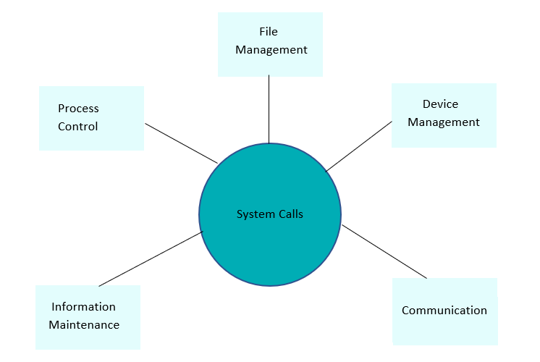

Slide 8
Thank you for your kind listening

